Slide 1
Advisor: Prof. Wen-Kai Tai
Student: Ze-Hao Wang

Slide 2
Agenda
Introduction
Related Works
Mission / Space framework
Map Sketches & Evolution of Segments
Proposed Methodologies
System Architecture
Mission Grammars
Room Instructions and Definitions
Genetic Algorithm in Segments Evolution
Experimental Results
Conclusions and Contributions
Future work

Slide 3
Introduction

Slide 4
Motivation

Slide 5
Research Goals

Slide 6
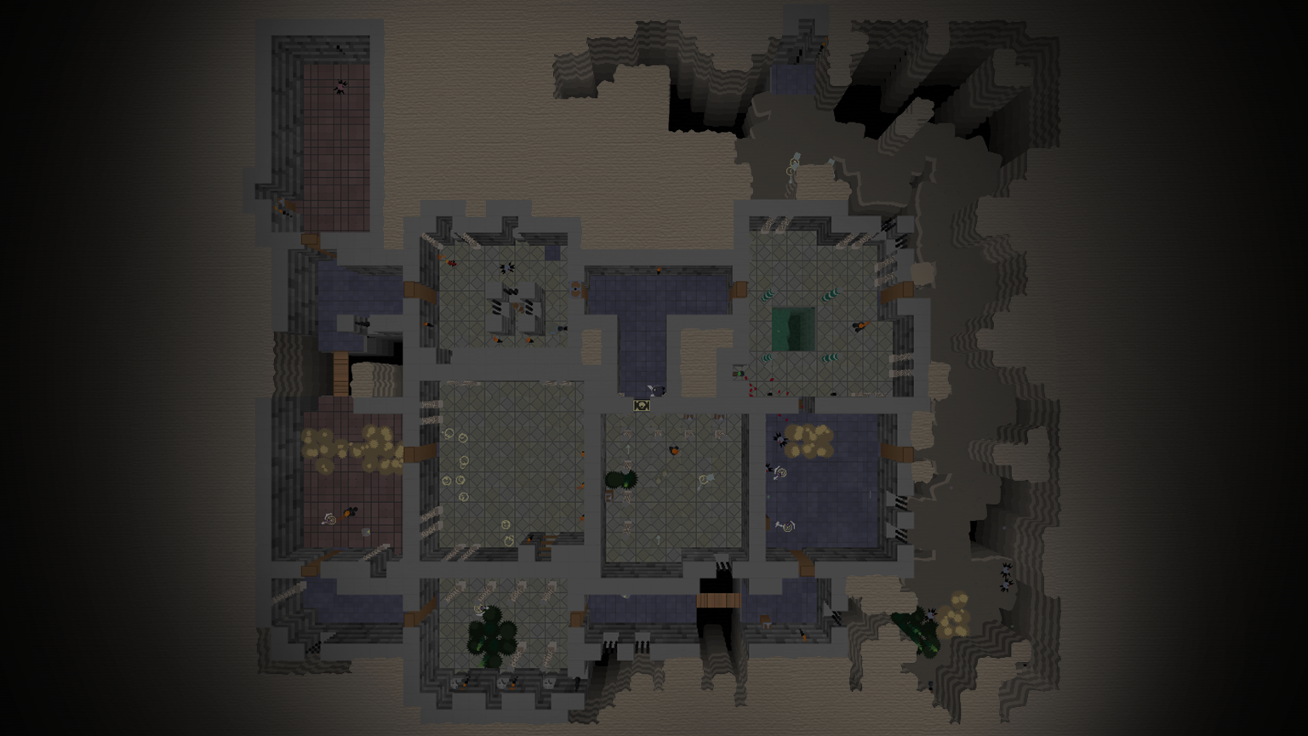
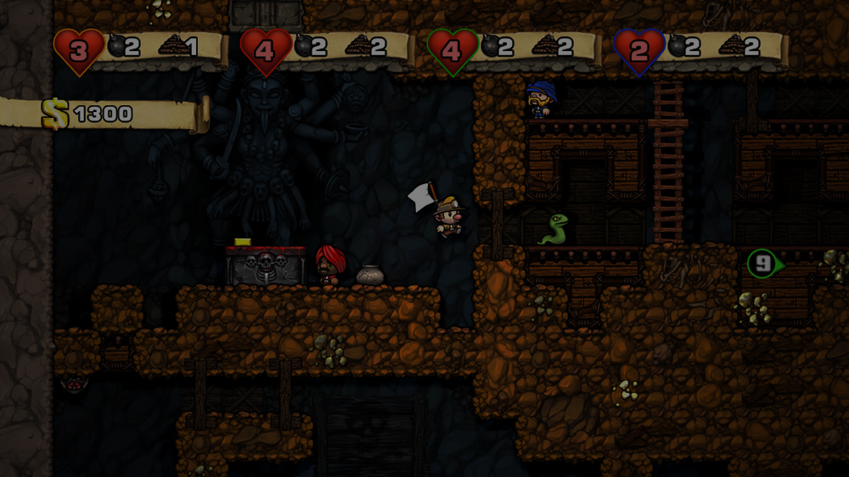
Related Works
Mission / Space framework
Map Sketches & Evolution of Segments

Slide 7
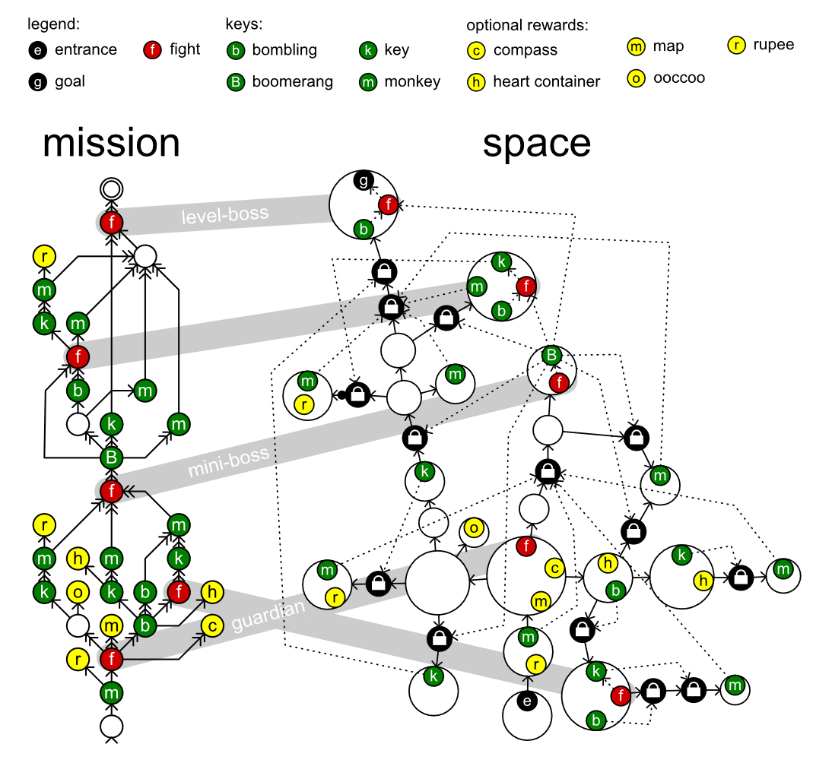
Mission / Space framework
Mission/Space framework, focuses on level design and the mechanics that control player progression through a game.
Transformational Grammars
Mission Grammars
Space Grammars
Mission Graph Convert into Space Graph

Slide 8
Transformational Grammars

Slide 9

Mission Grammars
Inhibitions
Available when at least one of the weak prerequisites is completed.
Strong requirement
Available when all strong prerequisites are completed.
Weak requirement
Available when at least one of the weak prerequisites is completed.
Example of mission graph
Mission graphs represent the players’ progress towards a goal not by tracking their physical location, but by tracking the tasks they must perform to finish a level.
A mission graph is a directed graph that represents a sort of to-do list with each node representing a task that might or must be executed by the players.

Slide 10
Space Grammars
k
t
g
t
k
e

Slide 11
Mission Graph Convert into Space Graph
The steps in the generation progress investigated in this paper in detail:
An alternative method, does not go into detail:
Mission
Map
Space
Refine
Level
Create
Space
Distill
Mission
Adjust
Space
Refine
Level
Create

Slide 12
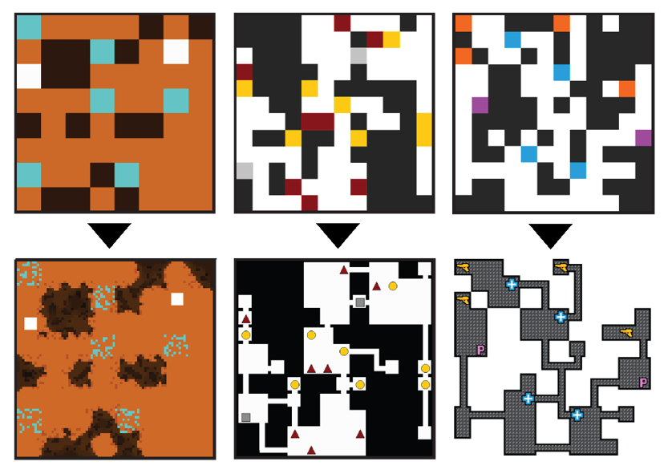
Map Sketches & Evolution of Segments
Mission/Space framework, focuses on level design and the mechanics that control player progression through a game.
Map Sketches
Map Sketch Evolution
Dungeon Segments
Dungeon Segment Evolution

Slide 13
Map Sketches

Slide 14
Map Sketch Evolution

Slide 15
Dungeon Segments

Slide 16
Dungeon Segment Evolution

Slide 17
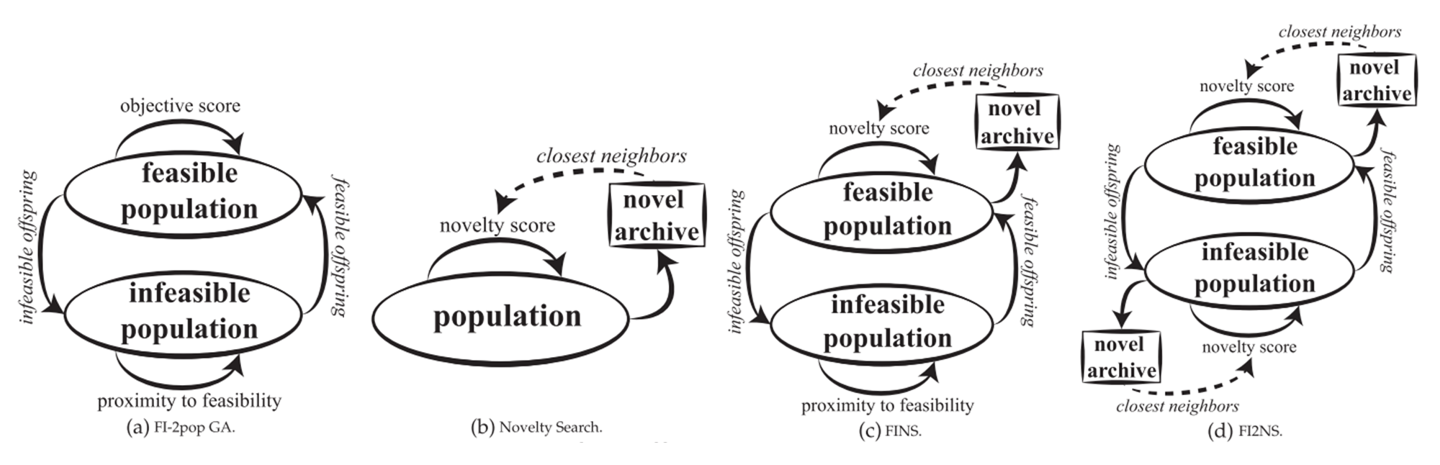
Constrained Novelty Search

Slide 18
Proposed Methodologies

Slide 19

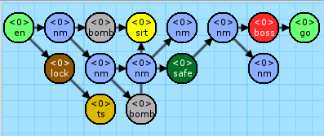


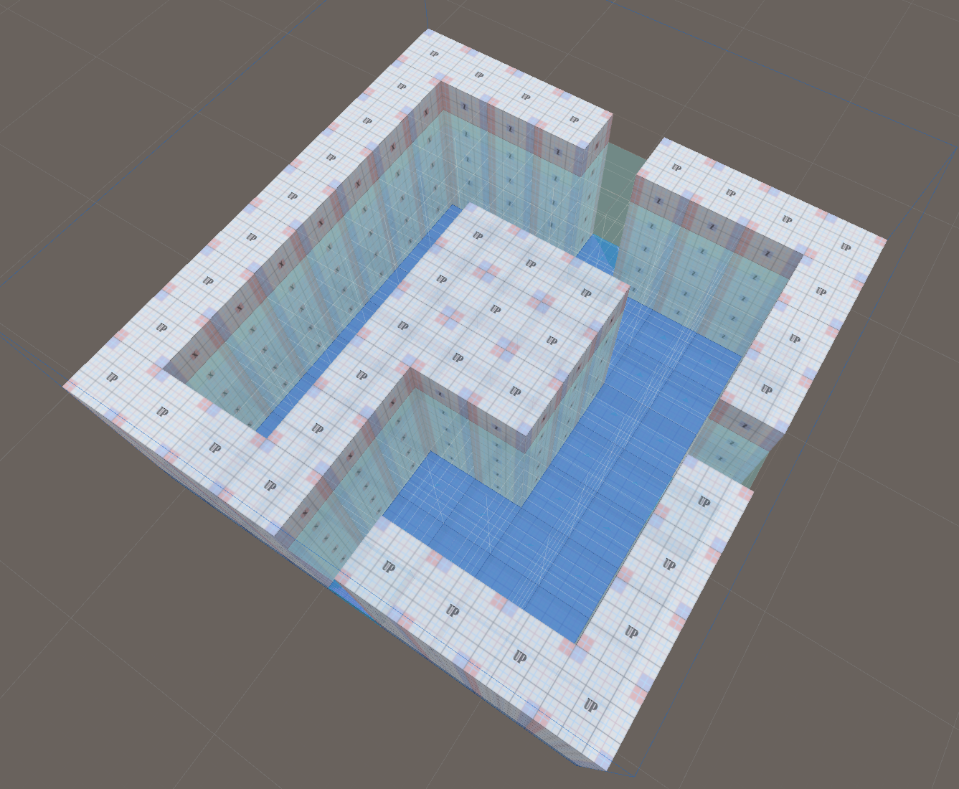
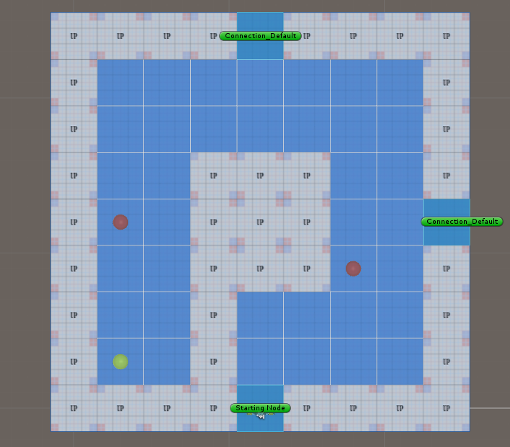
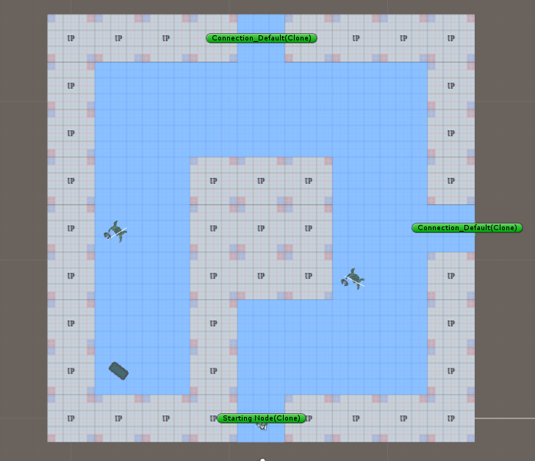
System Architecture
- Phase 1 - Mission / Space framework
- Phase 2 - Dungeon Segment Evolution
圖片 需更換

Slide 20
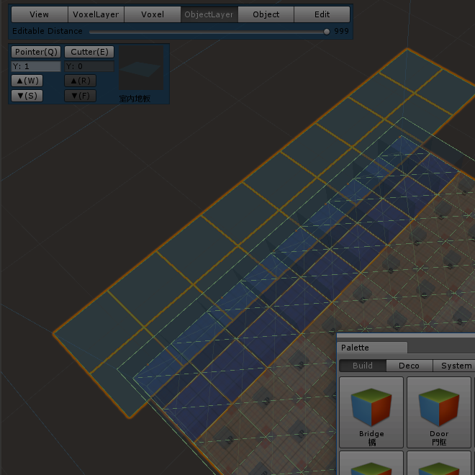
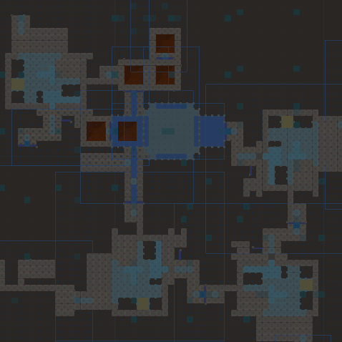
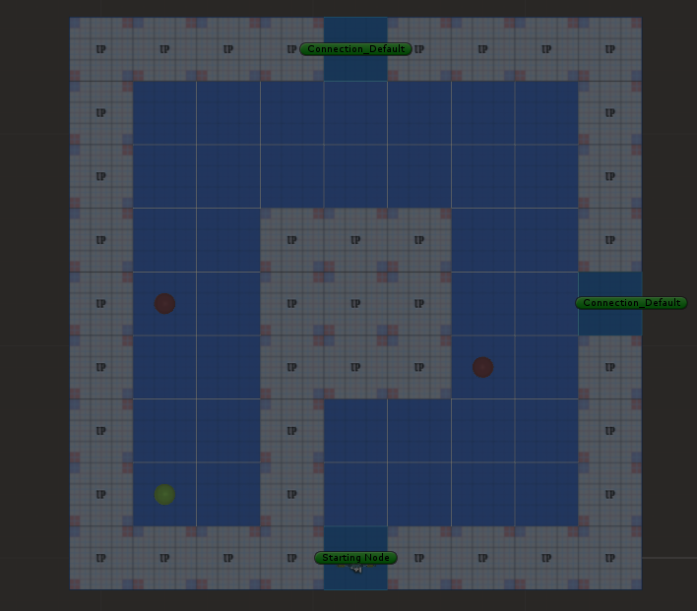
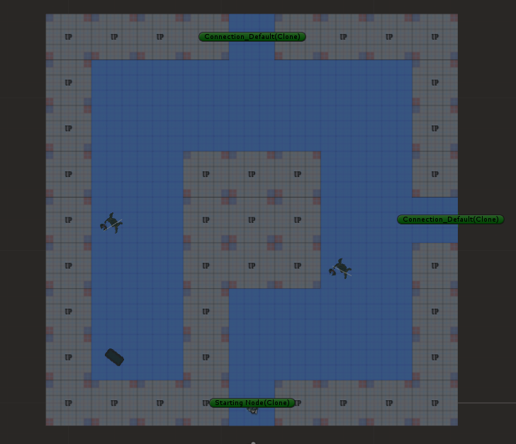
System Architecture
1. Create Mission Grammars
Recurrent constructions
Mission Alphabet
Terminal nodes & non-terminal nodes
Mission Rules
圖片 需更換

Slide 21
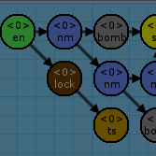

System Architecture
2. Create Volumes
Volex-based volumes
圖片 需更換

Slide 22
System Architecture
3. Generate the Space
Instructions of Rewrite System
圖片 需更換

Slide 23


System Architecture
4. Generate the Game Patterns
Genetic Algorithm for emergence objects
Nine main metrics to design the fitness functions
圖片 需更換

Slide 24
System Architecture
圖片 需更換

Slide 25
System DEMO
影片將會放置於此

Slide 26
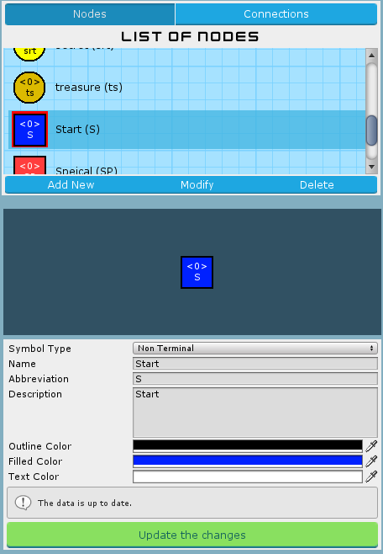
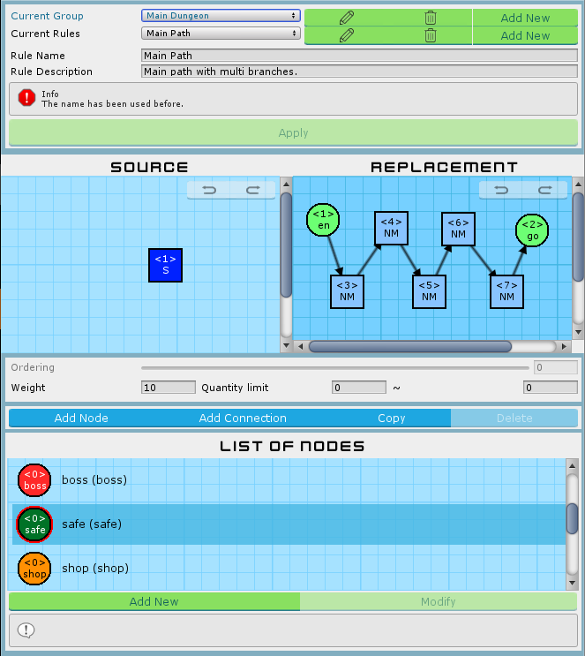
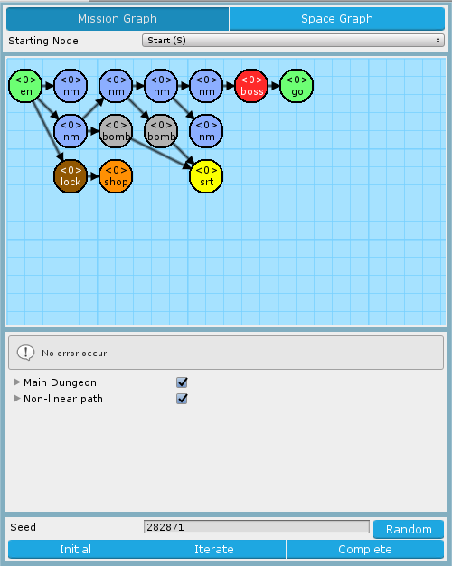
Mission Grammars

Slide 27
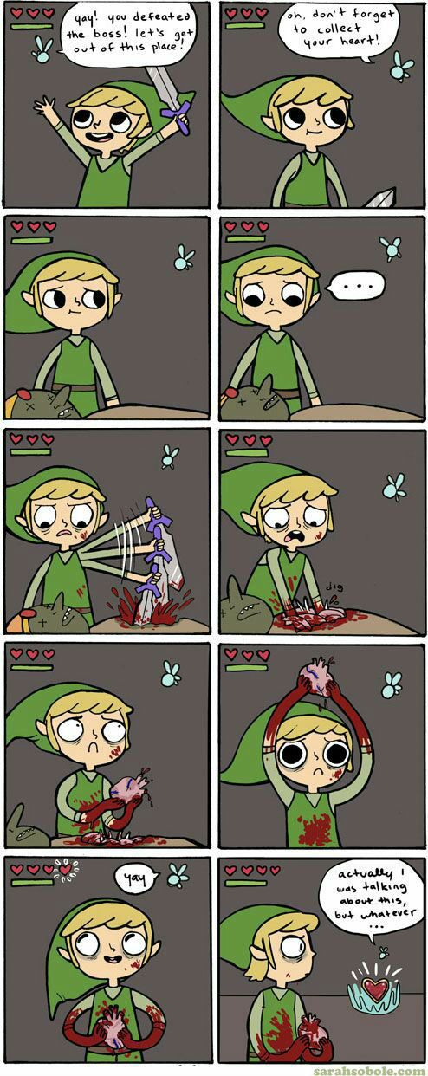
Recurrent construction in Game
Destroy
Survive
Collect

Slide 28
Room Instructions and Definitions

Slide 29
Genetic Algorithm in Segments Evolution
Genetic Algorithm
Algorithm flow
Gene
Crossover
Mutation
Nine fitness functions
Neglected
Block
Intercept
Patrol
Guard
Dominated
Support
Cover
Trap

Slide 30
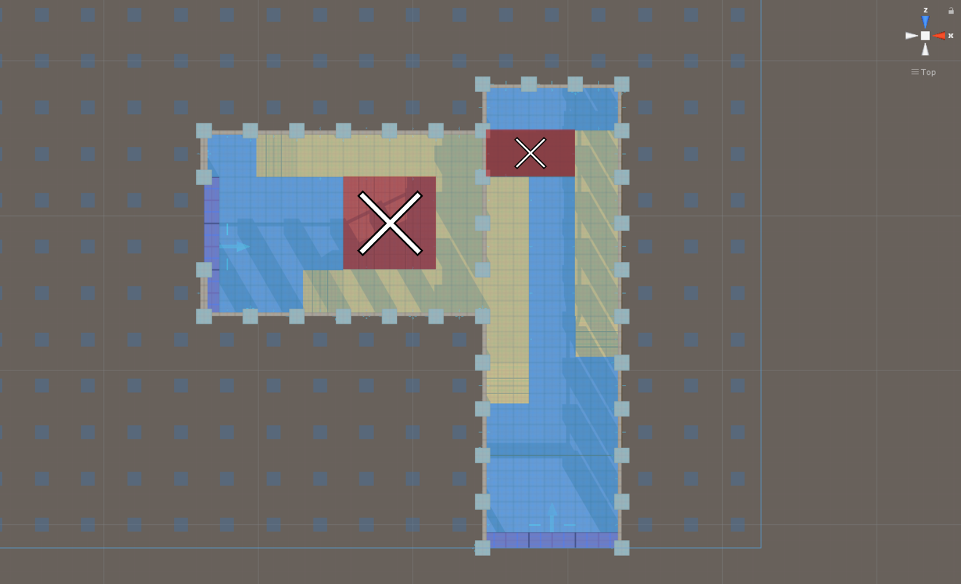
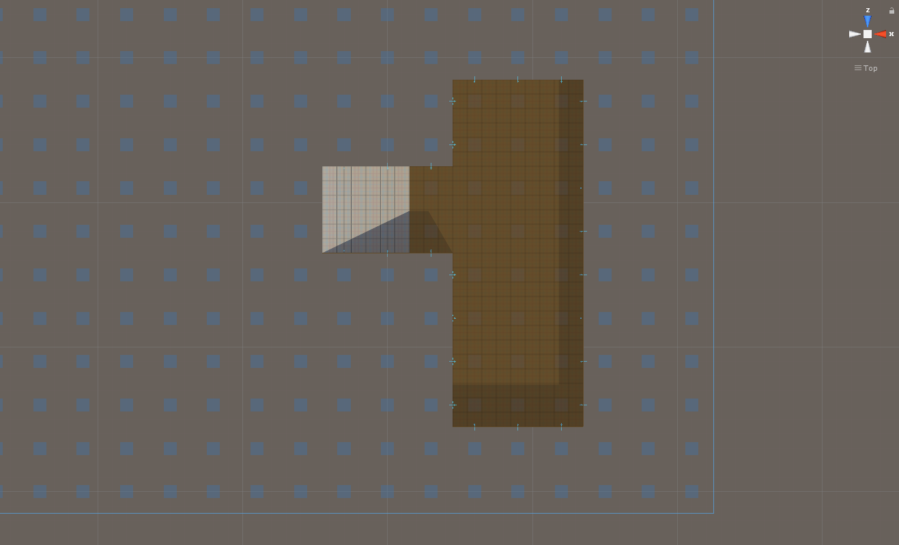


Gene
~
Basement
Gene Type
 | Empty
 | Enemy
 | Treasure
 | Trap
Gene
Ground
Individual (chromosome)
population

Slide 31
Crossover

Slide 32
Mutation

Slide 33
Experimental Results

Slide 35
Conclusions and Contributions

Slide 36
Conclusions

Slide 37
Contributions

Slide 38
Future Work

Slide 40
